Slide 1
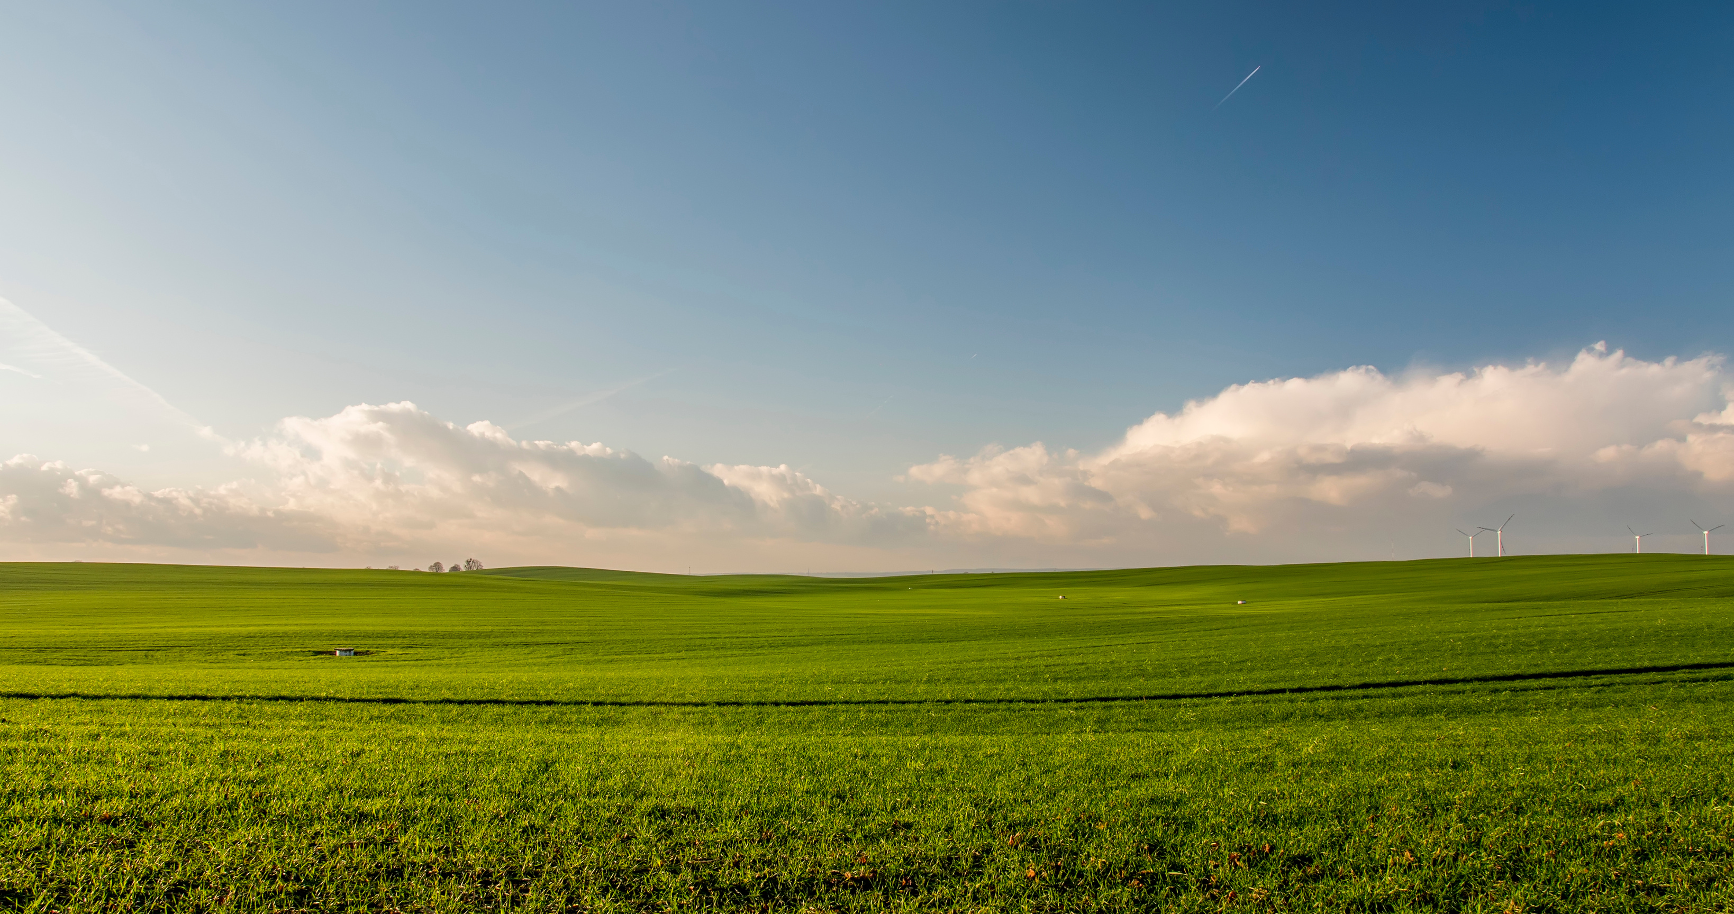


AGRIBLOCK
Traceability, Trust, and Transparency in the Food Supply Chain

Slide 2

02
Team Members
Hamza Muhammad Iqbal 503052
(Auth+BlockChain)
Muhammad Bilal Atif 501863
(Models+Mining)
Maaz Hussain 532844
(Traceability+API)
Muhammad Abdul Daym 507605
(Infrastructure+Networking)

Slide 3
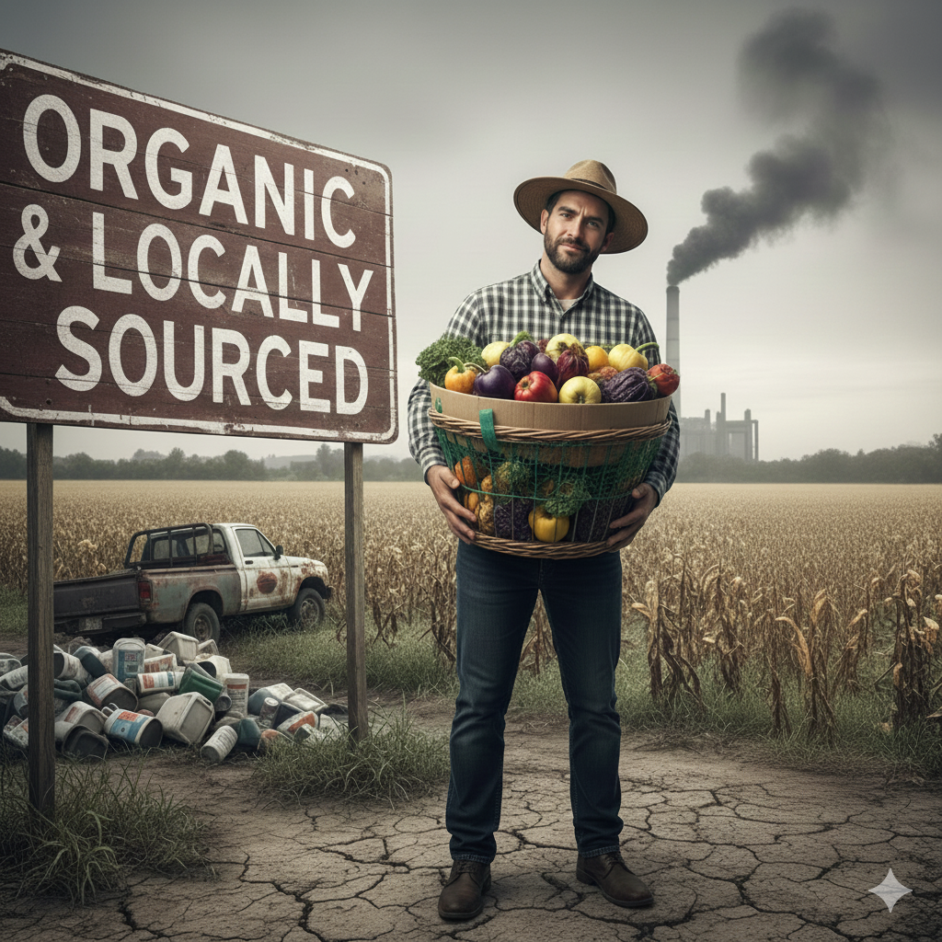
03
Challenge
Lack of transparency in the current food supply chain (e.g., food fraud, long recall times, difficulty tracing origin)
Impact
Health risks, financial losses for honest farmers, and consumer distrust.

Slide 4
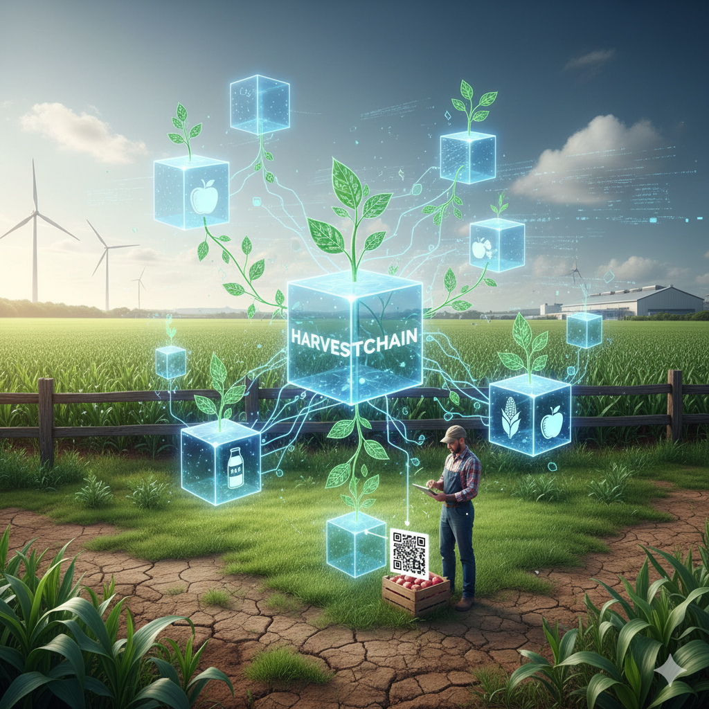
04
Our Solution
A concise, single-sentence value proposition: Agriblock uses Blockchain and IoT to create an immutable, transparent, farm-to-plate record for every food item.

Slide 5
05
The Agriblock Architecture
Core Components: Blockchain Network Smart Contracts
IoT Sensors
Web/Mobile Application.

Slide 6
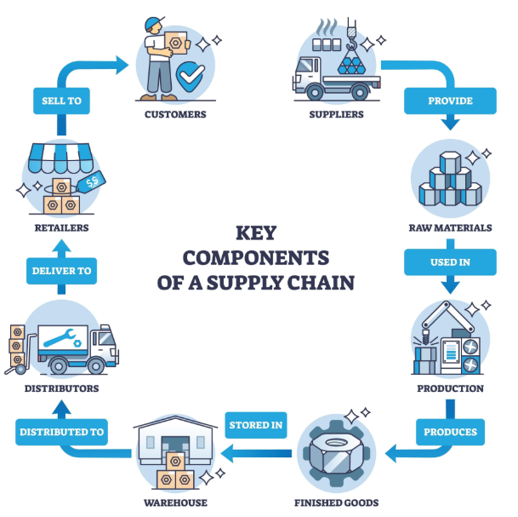
How It Works: The Data Journey
Step 1 (Farmer): Data (soil temp, humidity, fertilizer use) is collected by IoT Sensors.
Step 2 (Data Validation): Data is aggregated and written to the Blockchain ledger via Smart Contracts.
Step 3 (Consumer/Retailer): Scan a QR Code to access the immutable history.
06

Slide 7
07
The Blockchain Advantage
Immutability: Records cannot be altered, ensuring data integrity.
Transparency: All approved participants can view the history.
Decentralization: No single point of control or failure.

Slide 8
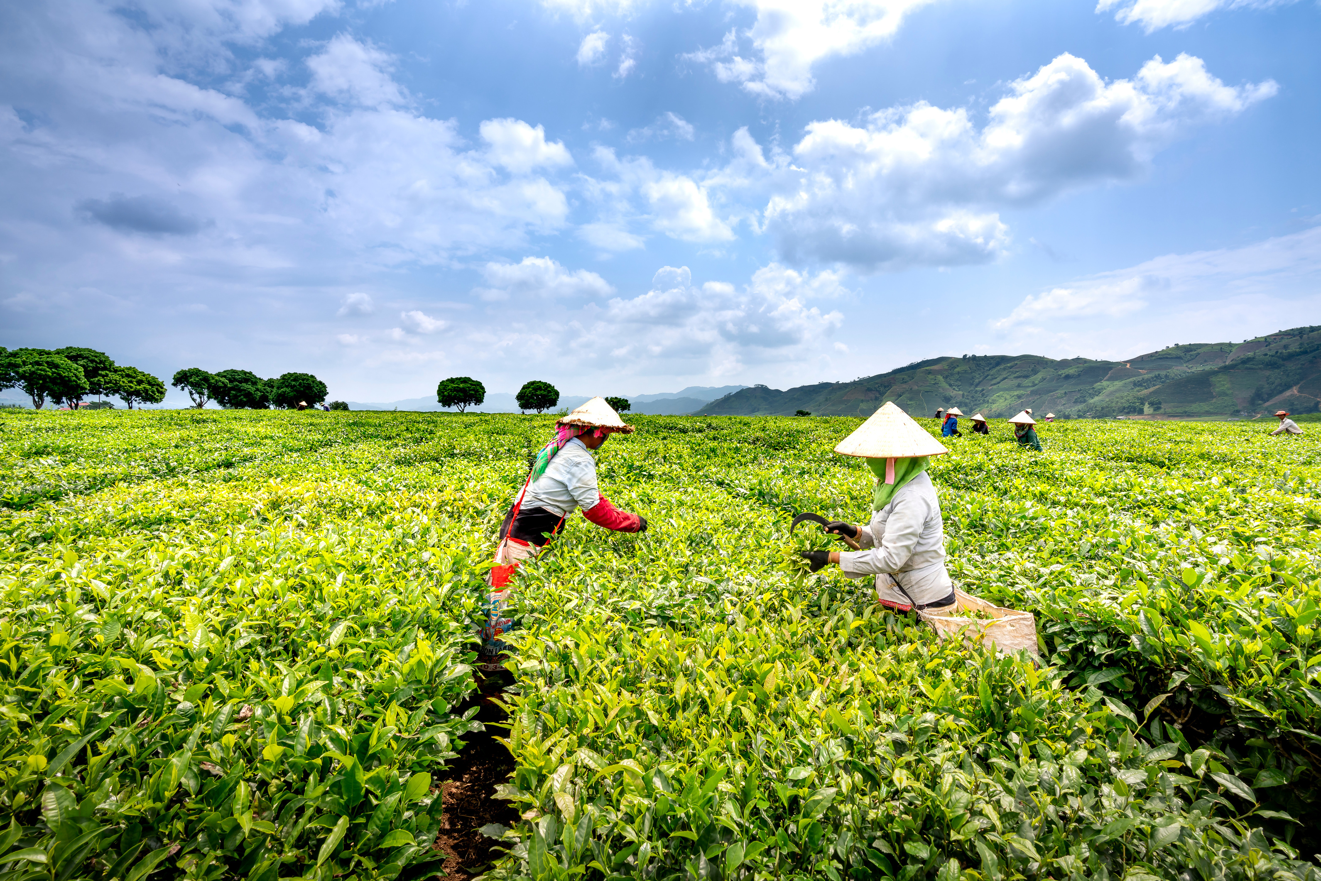
Key Features (The User Experience)
08
Consumer App
Regulatory Access
QR code scanning for origin and history.
Farmer/Supplier Dashboard
Instant audit trail for recalls/compliance.
Real-time IoT data monitoring

Slide 9

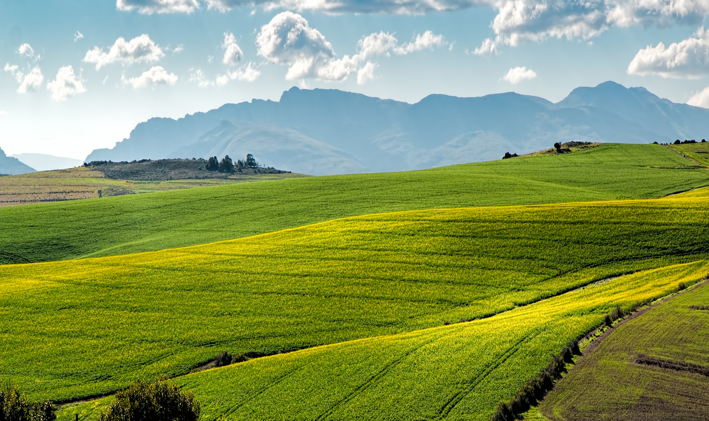
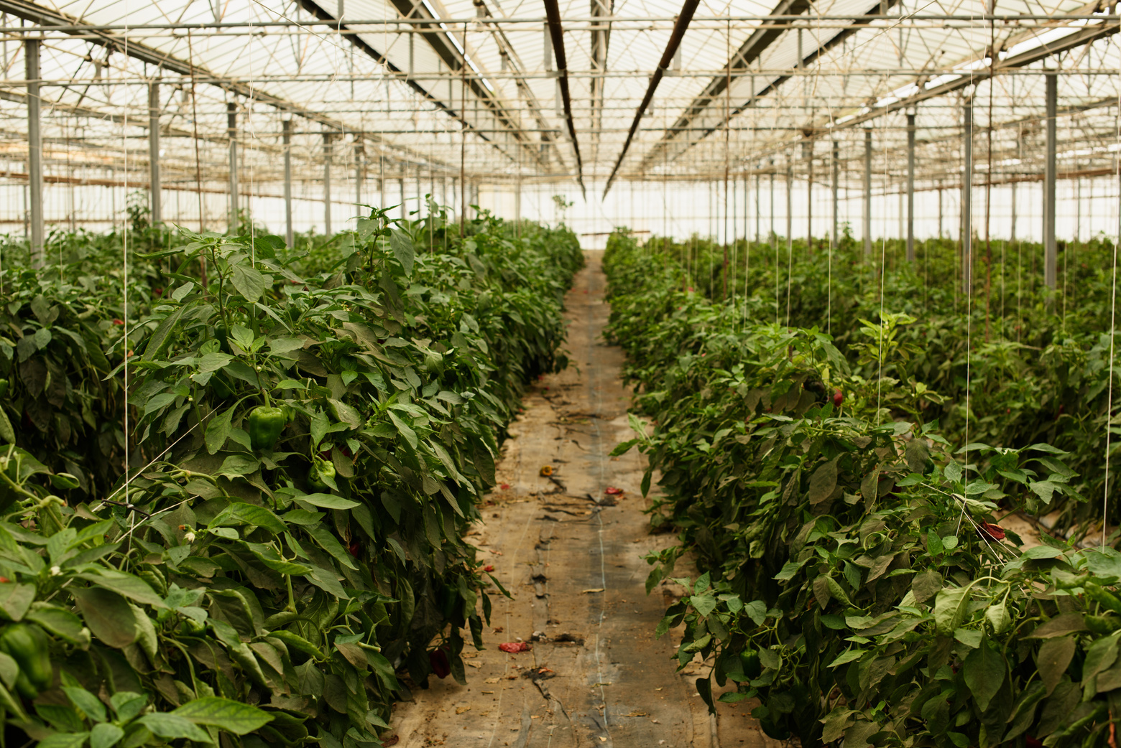
Conclusion & Call to Action
Impact: Improved consumer health, fair pricing for end users and farmers as well.
Vision: To be the global standard for agricultural product tracing.
09

Slide 10
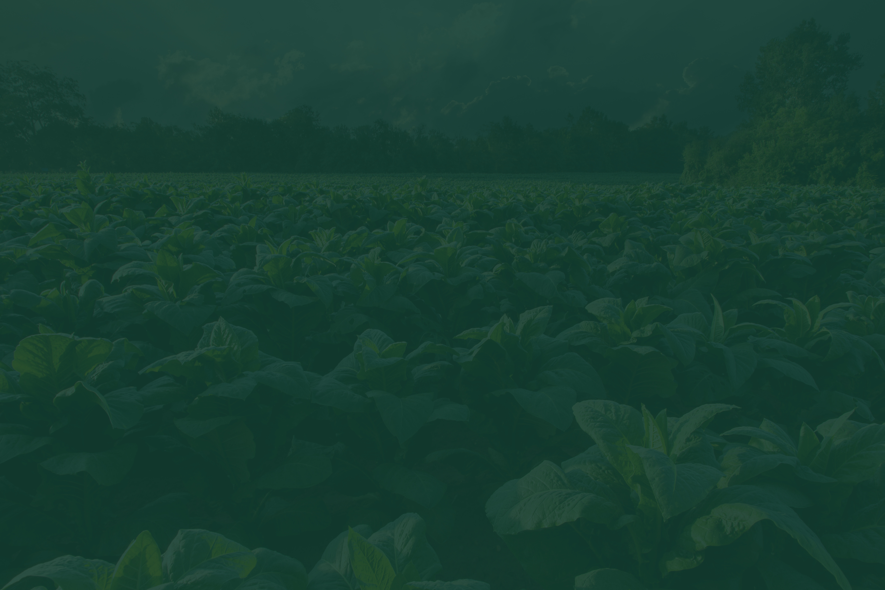
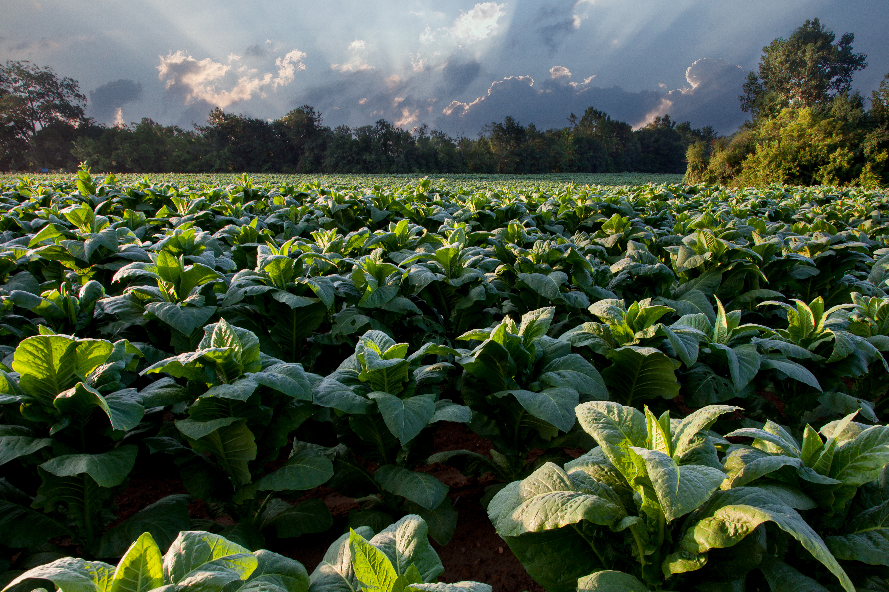
Thank You!
An apple a day , keep NUSTIAN away

